Slide 1
GIT Stash

Slide 2
Git allows multiple users to work on the same project simultaneously.
Suppose if a developer is working on a feature in a branch and he needs to pull changes from some other developer’s branch or if he has to work urgently on some other feature, but the feature he is currently working on is incomplete.
In this case, you cannot commit the partial code of the currently working feature.
To add this new feature, you have to remove your current changes and store them somewhere else. git stash command saves the previously written code and then goes back to the last commit for a fresh start.
Now you can add the new feature without disturbing the old one as it is saved locally.
After committing the new feature you can go on with working on the old feature which was incomplete and uncommitted.
For this type of situation, Git offers a very useful command known as ‘git stash‘.
Generally, the stash's meaning is "store something safely in a hidden place." The sense in Git is also the same for stash; Git temporarily saves your data safely without committing.
Stashing takes the messy state of your working directory, and temporarily save it for further use. Many options are available with git stash.

Slide 3
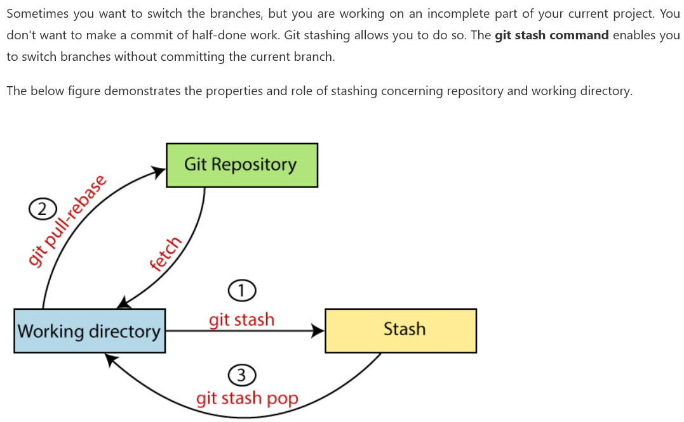
What is Git Stash?

Slide 4
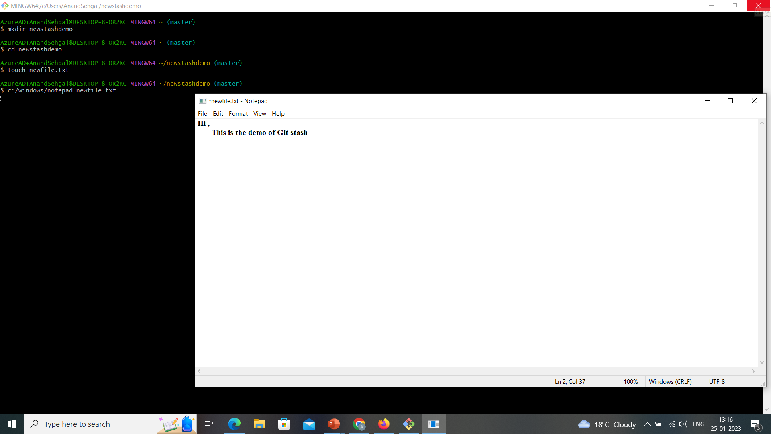

Slide 5
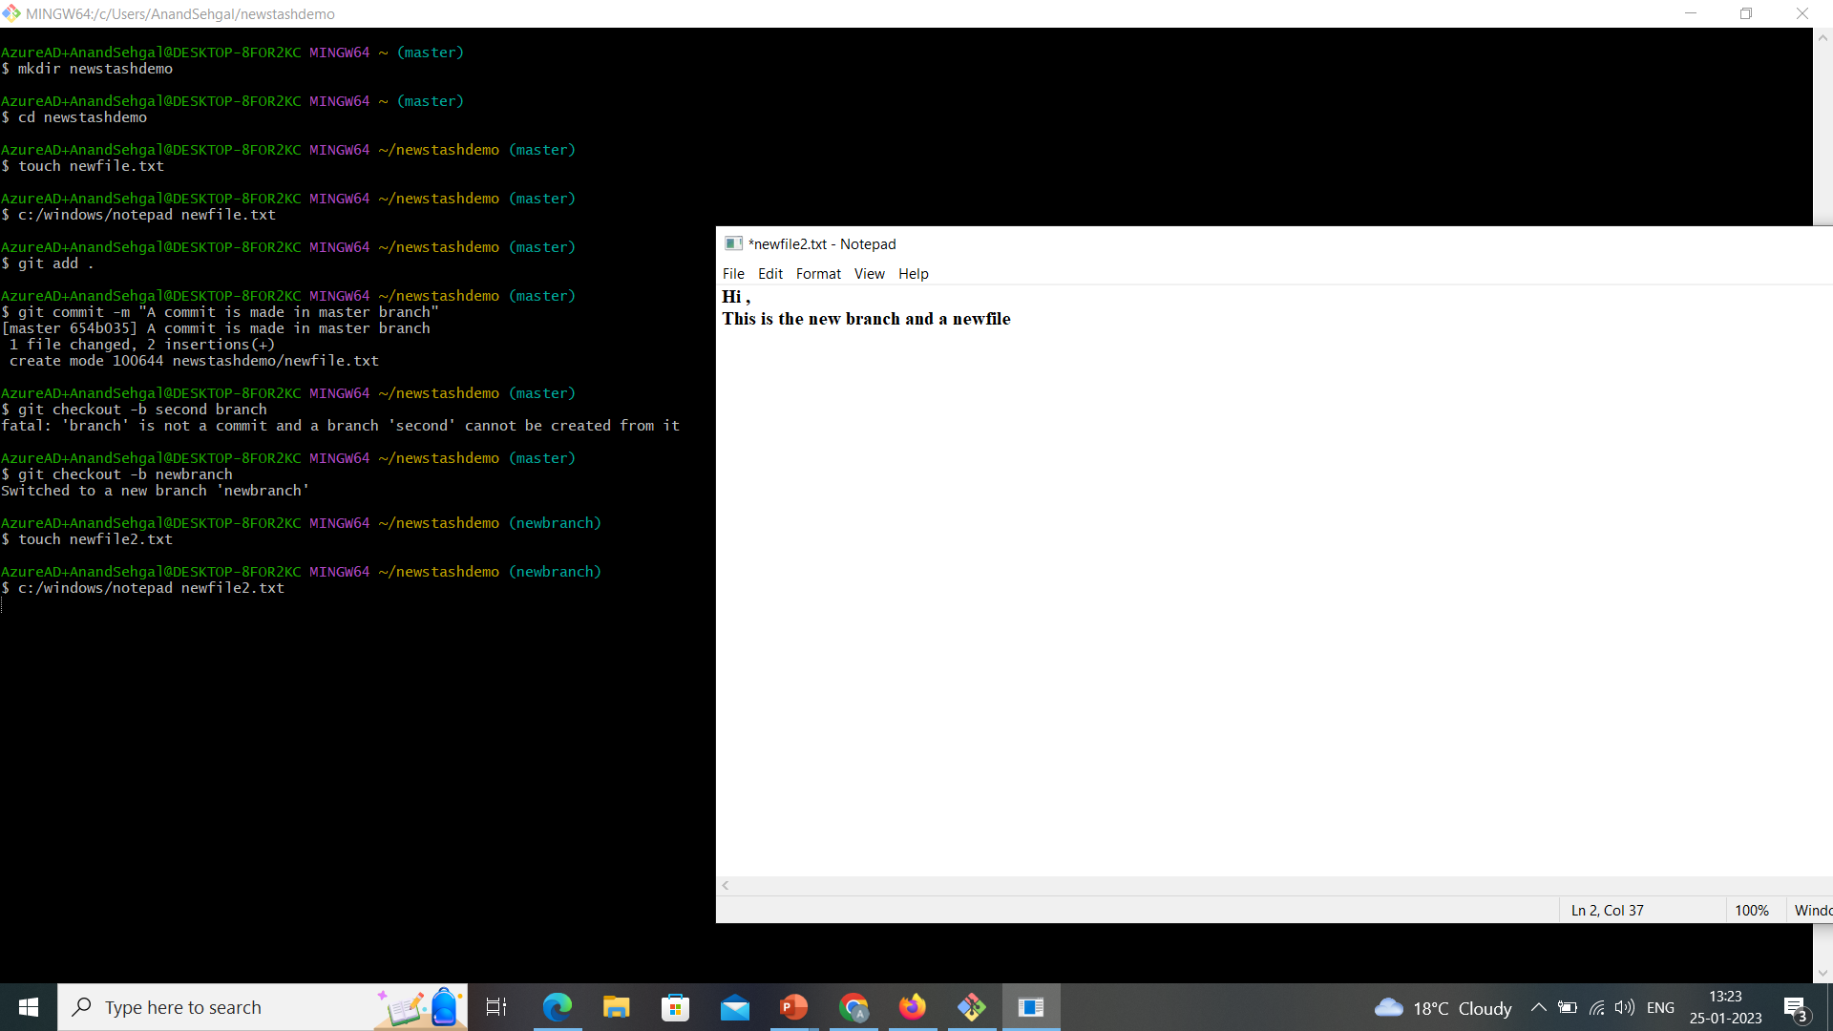

Slide 6
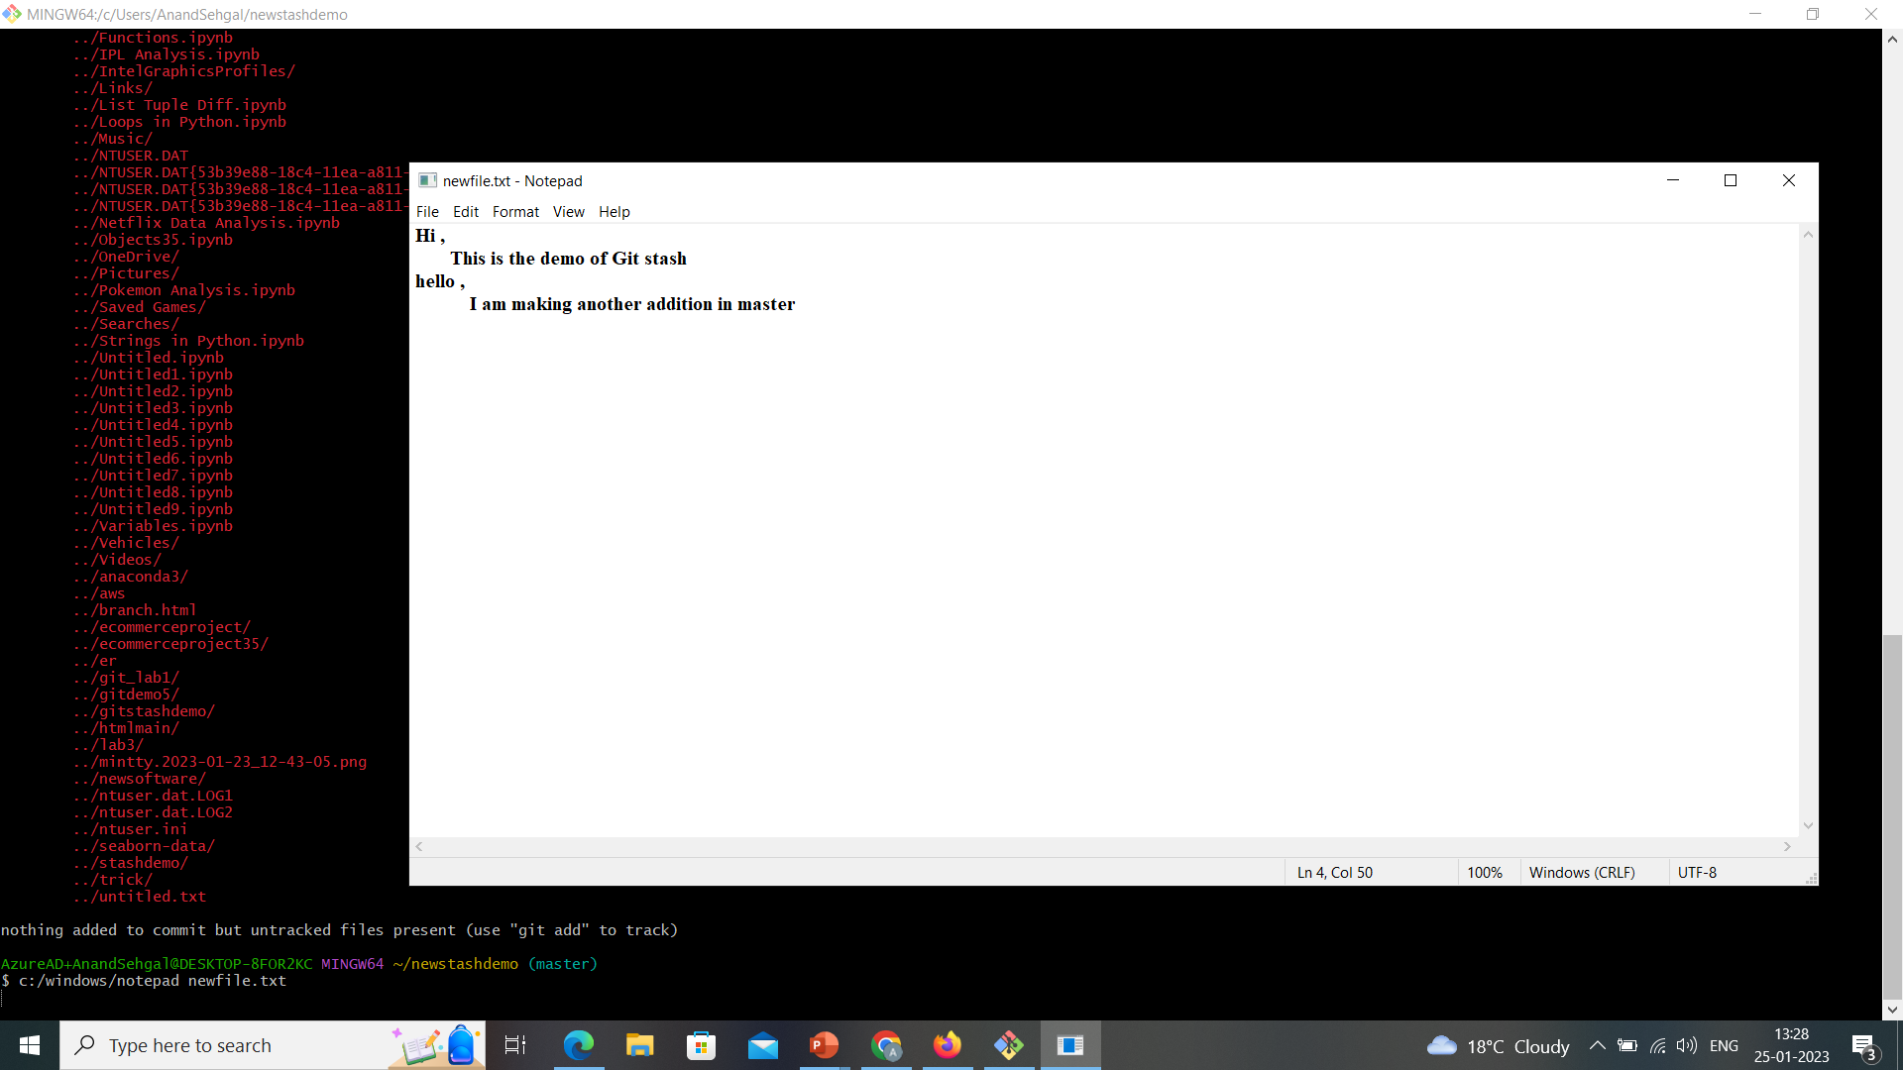

Slide 7
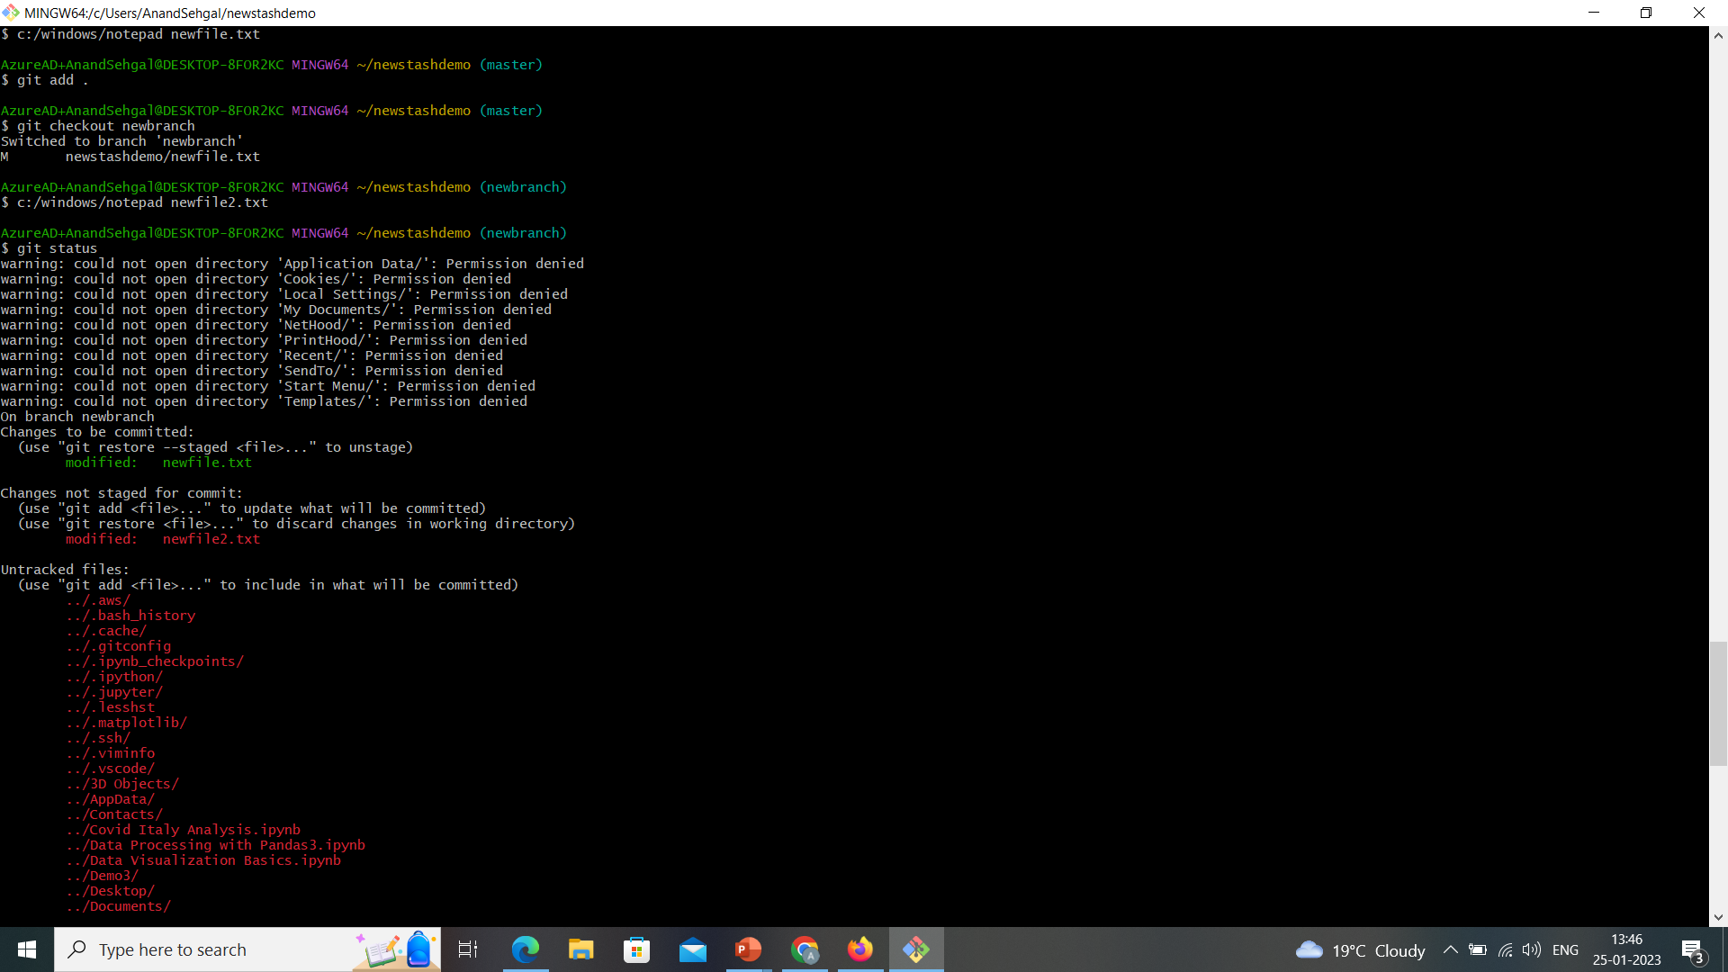

Slide 8
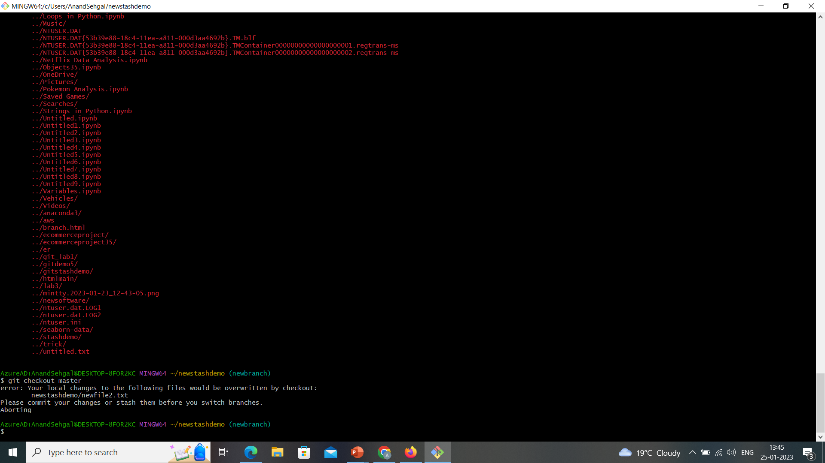

Slide 9
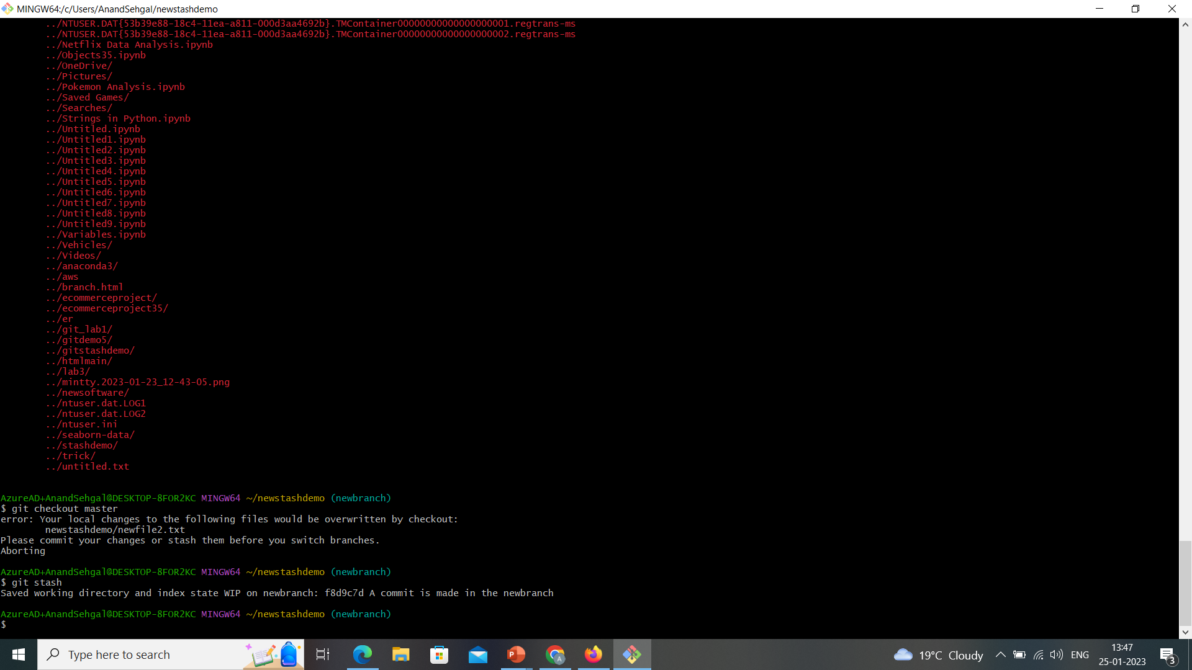

Slide 10
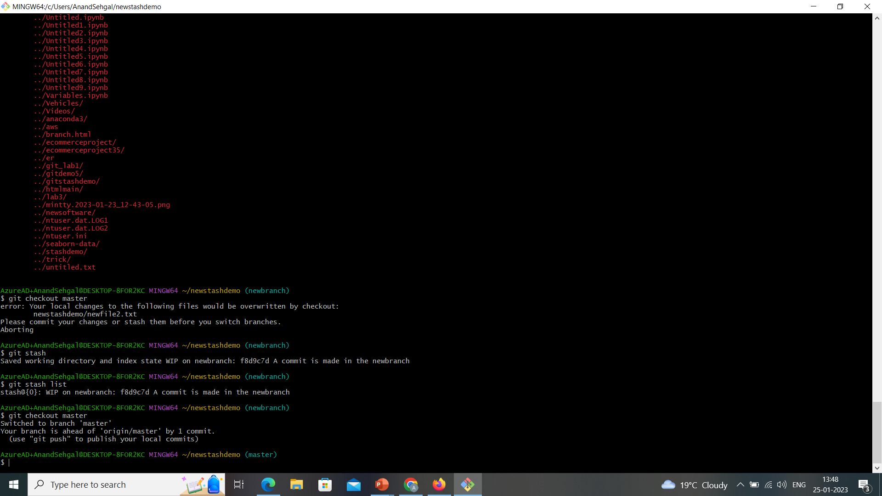

Slide 11
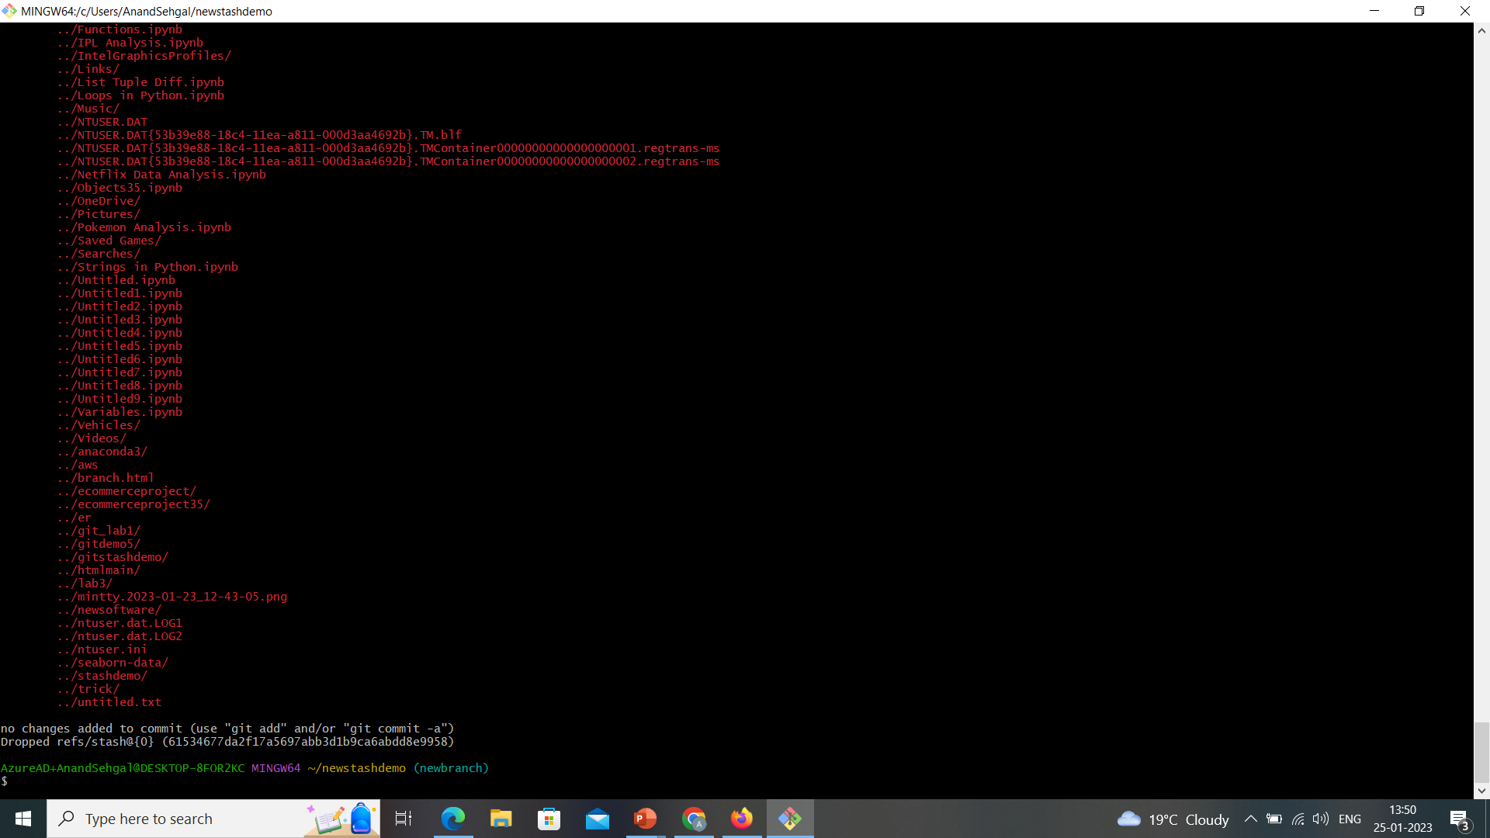

Slide 12
